Slide 1






Manasvi Goyal ¹, Ianna Osborne ², Jim Pivarski ²
¹ Delhi Technological University
² Princeton University
Support for this work was provided by National Science Foundation cooperative agreement OAC-1836650.
Notes:
Support for this work was provided by NSF cooperative agreement OAC-1836650 (IRIS-HEP)

Slide 2

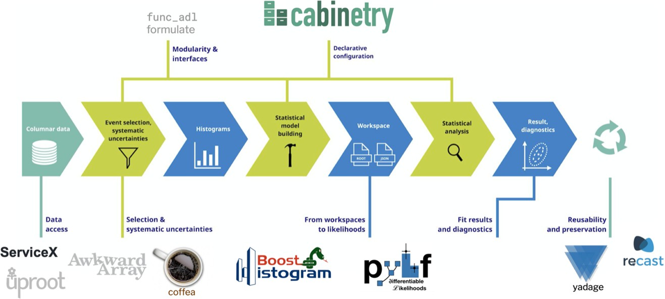

Awkward Arrays
Awkward Array is a library for nested, variable-sized data, including arbitrary-length lists, records, mixed types, and missing data, to manipulate JSON-like data using NumPy-like idioms.
ACAT 2022
The Awkward World of Python and C++
2
Notes:
I’ll start by giving a brief overview. Awkward Array is a Scikit-HEP library for nested, variable-sized data, including arbitrary-length lists, records, mixed types, and missing data, used to manipulate JSON-like data using NumPy-like idioms.
Arrays are dynamically typed, but operations on them are compiled and fast. Their behavior coincides with NumPy when array dimensions are regular and generalizes when they're not. Awkward Arrays are not only more concise, but they are much faster and use less memory than the equivalent Python expression.
They are used in HEP and other scientific communities

Slide 3
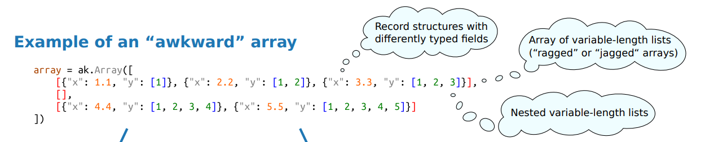
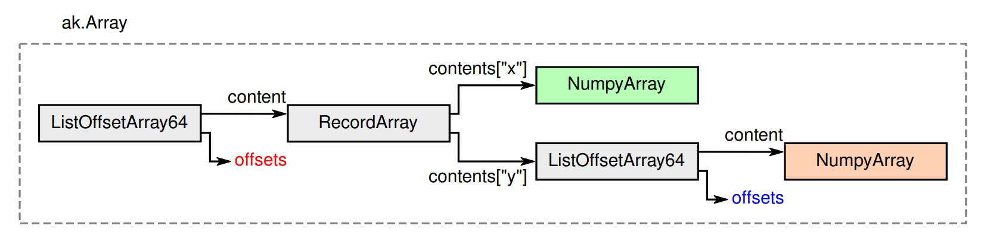
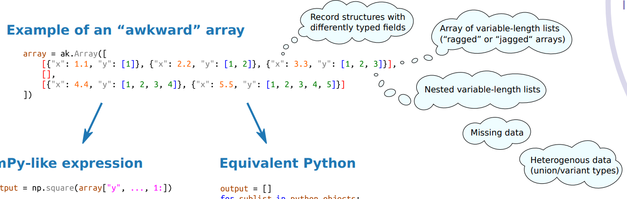
How it works?
ACAT 2022
The Awkward World of Python and C++
3
Notes:
An entire array consists of one small tree with large, contiguous data buffers attached to each node (color coded with the above).
Compiled operations are performed on these data buffers, not the objects they represent.

Slide 4
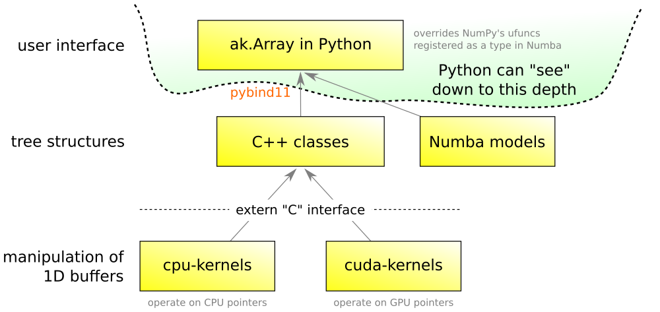
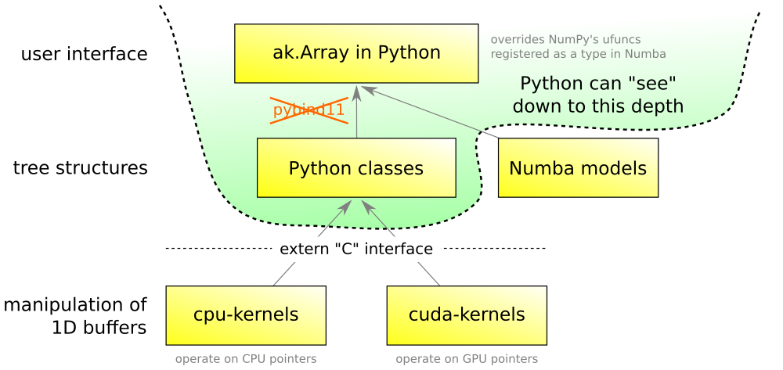
Evolution of Architecture
Awkward 2.x
Awkward 1.x
Lessons learned in Python-C++ integration
Jim Pivarski, Princeton University, ACAT 2021
ACAT 2022
The Awkward World of Python and C++
4
Notes:
Awkward 1.x moved loops over arrays from NumPy to specialized compiled "kernels." That was good. It also moved the implementation of Awkward's tree structures into C++. That was bad.
This presentation represents the evolving view of best practices for creating Awkward Arrays in C++. Previously, the main codebase was written in C++ with the idea that downstream code would link to libawkward.so, but as Jim described in his talk at the ACAT, that route is full of hidden gotchas. That’s why the Awkward tree manipulation needed to be reimplemented back into Python to make it more transparent to other Python libraries.
We've moved from C++ owning the data (ArrayBuilder based on std::shared_ptr that is shared with Python) to Python owning the data (a copy of std::unique_ptr data in C++ to a NumPy-allocated array—until a few weeks ago.

Slide 5


Python-C++ Integration
Binding Python and C++ to get advantage of best features of both languages.
The header-only implementation allows using Awkward Arrays in an external project without linking to the awkward libraries.
No specialised data types - only raw buffers, strings, and integers.
The header only implementation allows for multiple applications.
ACAT 2022
The Awkward World of Python and C++
5
Notes:
More front-ends use Python, but large-scale processing still needs to have high performance. So, we combine Python and C++ to get advantage of best features of both languages so that we can have Python user interface and at the same time take advantage to the performance and memory management of C++. This is especially relevant to the HEP and other scientific communities that have invested heavily in the C++ frameworks and are rapidly moving their data analyses to Python. (Bridging the gap between the 2 languages)
So, how to do it right? This is the main question that will be answered in upcoming slides.
Awkward Array v2, introduces header-only C++ libraries that do not depend on any application binary interface. The method of a small, header-only library that only fills array buffers for downstream code to pass from C++ to Python using C types (integers and raw pointers) has considerably more promise.
A mini package containing these header files now reside in a separate directory. The users can directly include it in their compilation, rather than linking against platform-specific libraries. This new development makes the integration of Awkward Arrays into other projects easier and more portable as the implementation is easily separable from the rest of the Awkward Array codebase.
The code does not include all of the code needed to use Awkward Arrays in Python, nor does it include references to Python or pybind11. The C++ users can use it to make arrays and then copy them to Python without any specialised data types - only raw buffers, strings, and integers. This C++ code also simplifies the process of JIT-compilation in ROOT. Generating of all the types via templates makes it easier to dynamically generate LayoutBuilder from strings in Python and then compiling it with Cling.
This implementation solves some of the drawbacks like packaging projects where native dependencies can be challenging.

Slide 6
Layout Builders
“Layout” consists of composable elements that determine how an array is structured.
Designed to build Awkward Arrays faster because it knows the type. (ArrayBuilder - discovers the type)
Implementation details: C++14, header only, etc..
It uses header-only GrowableBuffer (see backup slides for details).
awkward::LayoutBuilder specializes an Awkward data structure using C++ templates, which can then be filled and converted to a Python Awkward Array through ak.from_buffers.
ACAT 2022
The Awkward World of Python and C++
6
Notes:
“Layout” consists of composable elements that determine how an array is structured. it can only build a specific view determined by the layout form. The data comes out of LayoutBuilder as a set of named buffers and a Form (JSON) that tells Awkward Array how to put it all together.
We use both ArrayBuilder and LayoutBuilder to create Awkward arrays. The biggest difference between a LayoutBuilder and an ArrayBuilder is that the data types that you can append to the LayoutBuilder are restricted by its Form, while you can append any data types to an ArrayBuilder (more generic). So, why use Layout Builders when we have ArrayBuilders which is more flexible? The answer is performance. LayoutBuilders are designed to build Awkward Arrays faster. The flexibility of ArrayBuilder comes with performance limitations since it needs to discover the data type while LayoutBuilder knows it in advance.
Now we have a Layout Builder with a set of compile time, templated static C++ classes, implemented entirely in header files.
LayoutBuilder now uses GrowableBuffer so the GrowableBuffer which is implemented as a linked list with smart pointers.
The LayoutBuilder code doesn't have helper methods to pass the data through pybind11 so that different projects can use different binding generators. (It's currently being used in one Cling project, Awkward ↔ RDataFrame, and one Cython project, ctapipe.) So here's an explanation of how to use it with pybind11.

Slide 7

Record Builder Example
#include "awkward/LayoutBuilder.h"
enum Field : std::size_t {x, y};
UserDefinedMap fields_map({
{Field::x, "x"},
{Field::y, "y"}});
RecordBuilder<
RecordField<Field::x, NumpyBuilder<double>>,
RecordField<Field::y, ListOffsetBuilder<int64_t,
NumpyBuilder<int32_t>>>
> builder;
builder.set_field_names(fields_map);
auto& x_builder = builder.field<Field::x>();
auto& y_builder = builder.field<Field::y>();
x_builder.append(1.1);
auto& y_subbuilder =
y_builder.begin_list();
y_subbuilder.append(1);
y_builder.end_list();
Filling the Layout Builders
Record 1
Constructing a Layout Builder from variadic templates!
x_builder.append(2.2);
y_builder.begin_list();
y_builder.end_list();
Record 2
x_builder.append(3.3);
y_builder.begin_list();
y_subbuilder.append(1);
y_subbuilder.append(2);
y_builder.end_list();
Record 3
Equivalent Array
[
{"x": 1.1, "y": [1]},
{"x": 2.2, "y": []},
{"x": 3.3, "y": [1, 2]},
]
ACAT 2022
The Awkward World of Python and C++
7
Notes:
Let’s take an example of one of the most interesting Layout Builders. An array of events with one-value-per-event attributes and different-length lists of particles can be modeled using only records (structs) and variable-length lists. Here's an example of building that with LayoutBuilder:
This is how user code looks like…
He we have a RecordLayoutBuilder with the fields as Numpy LB and ListOffset LB. So the user needs to fill 3 buffers - Numpy data (double), ListOffset offers (int64_t) and Numpy data (int32_t) in the list. The user can have the option to use. Int32, uint32 and int64 as the type for list offsets.
The builder content is a heterogeneous type container (std::tuple). The field names are non-type template parameters defined by a user. Note, we cannot template on std::string because this feature comes only from C++20. That is why a user has to provide a map for passing the field_names as parameters to the Record LB. To do anything on the tuple use lambdas.
Right side - This is how user can add data to the builders to make records.
3 records (explain). And Thearray will look something like this
We want NumPy to own the array buffers, so that they get deleted when the Awkward Array goes out of Python scope, not when the LayoutBuilder goes out of C++ scope. For the hand-off, you can allocate memory for those buffers in Python, presumably with np.empty(nbytes, dtype=np.uint8) and get void* pointers to these buffers by casting the output of numpy_array.ctypes.data (pointer as integer).
Now you can pass everything over the border from C++ to Python using pybind11's py::buffer_protocol for the buffers, as well as an integer for the length and a string for the Form.

Slide 8

Record Builder User Interface
Layout Builder Form
Retrieve the set of buffer names and their sizes (as a no. of bytes):
std::map<std::string, size_t> names_nbytes = {};
builder.buffer_nbytes(names_nbytes);
{
"class": "RecordArray",
"contents": {
"x": {
"class": "NumpyArray",
"primitive": "float64",
"form_key": "node1"
},
"y": {
class": "ListOffsetArray",
"offsets": "i64",
"content": {
"class": "NumpyArray",
"primitive": "int32",
"form_key": "node3"
},
"form_key": "node2"
} "
},
"form_key": "node0"
}
Allocate memory for these buffers in Python np.empty(nbytes, dtype=np.uint8)and get void* pointers to these buffers by casting the output of numpy_array.ctypes.data.
Let the LayoutBuilder fill these buffers:
std::map<std::string, void*> buffers;
builder.to_buffers(buffers);
More examples
Finally, you get the JSON form with:
std::string form = builder.form();
ACAT 2022
The Awkward World of Python and C++
8
Notes:
What are the names, size (in bytes) and number of the buffers? - Map the node names to the numbers of bytes in the nodes. At this point, the buffer is still a sequence of panels. This is an internal implementation detail to extract the data because we already have `ak.from_buffers` function
What data is filled in the buffers? - For form_key "node" and a user-given pointer, fill the data into this pointer. When the LayoutBuilder is filling this user-owned buffer, it does the concatenation while copying.
The user can -
Check the validity of the buffer by is_valid() to make sure there are no errors. The user can call it on every entry if they want to trade safety for speed.
Retrieve the information needed to allocate the empty buffers as a map of their names (the form node keys as defined by the LayoutBuilder) to their sizes in bytes.
Allocate the buffers, map using the user-given pointer and same names/sizes as above, and fill the data in the pointers.
The is how the Awkward Form looks like. It is a is a unique description of an Awkward Array & returns a std::string. (JSON-like). It consists of details like class name, contents of the class, primitive type and form keys.
Moreover, we want NumPy to own the array buffers, so that they get deleted when the Awkward Array goes out of Python scope, not when the LayoutBuilder goes out of C++ scope. The hand-off therefore needs a few steps.
First, you ask for the set of buffer names and their sizes, as a number of bytes (not a number of items):
Next, you allocate memory for those buffers in Python, presumably with np.empty(nbytes, dtype=np.uint8) and get void* pointers to these buffers by casting the output of numpy_array.ctypes.data (pointer as integer).
Then, you let the LayoutBuilder fill these buffers with
Finally, you get the JSON form with
Now you can pass everything over the border from C++ to Python using pybind11's py::buffer_protocol for the buffers, as well as an integer for the length and a string for the Form.
if you ever need to make a change to the format of the records—add, remove, rename, change the type of a field—you don't need to change anything in the Python-C++ interface. All of that is contained in the specialization of the C++ template and the filling procedure, which are both in your C++ code.

Slide 9
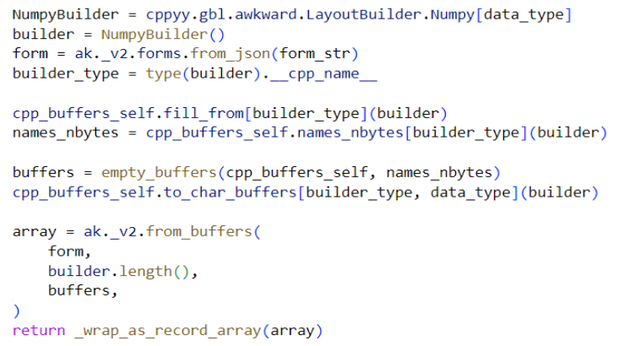
Awkward Arrays from RDataFrame
ak.from_rdataframe converts the selected columns as native Awkward Arrays.
Uses the C++ header-only implementation to simplify JIT compilation.
Awkward Arrays to RDataFrame and back
See Ianna Osborne’s poster!
ACAT 2022
The Awkward World of Python and C++
9
Notes:
This is an example how Layout builder is used for Awkward RDF. Using the the header-only C++ library, makes it simplifies the process of JIT-compilation - using cppyy
(which needs the header-only library to JIT-compile)
Dynamic project
A Pythonized by cppyy C++ header-only class converts the data to the Numpylike buffers • The C++ templated header-only implementation constructs the Form from the data types

Slide 10

Awkward Array in ctapipe
A EventIO format (a machine-independent hierarchical data format)
An event has the following attributes:
header: a namedtuple containing the Corsika Event Header data
end_block: a numpy array containing the Corsika Event End data
time_offset, x_offset, y_offset: the offset of the array
A framework for prototyping the low-level data processing algorithms for the Cherenkov Telescope Array.
Refactor their implementation to use Awkward Array
Array types are known in at compile time.
ACAT 2022
The Awkward World of Python and C++
10
Notes:
Particle astrophysicists have a project called ctapipe (in gamma ray astronomy) which is a framework for prototyping the low-level data processing algorithms for the Cherenkov Telescope Array. It does some processing on structured ("awkward") event data, and they want to refactor their implementation to use Awkward Array.
They already have C++ code that iterates over the custom file format(a machine-independent hierarchical data format) (which has array types that are known at compile-time) (not ROOT). The easiest way for them to get Awkward Arrays is to use a LayoutBuilder to fill some buffers and then send that to Python through pybind11.
An event has the following attributes: * header: a namedtuple containing the Corsika Event Header data * end_block: a numpy array containing the Corsika Event End data * time_offset, x_offset, y_offsett, the offset of the array
Cython project
ctapipe is a framework for prototyping the low-level data processing algorithms for the Cherenkov Telescope Array.

Slide 11

Summary
Header-only libraries that only fills buffers for downstream code to pass from C++ to Python using only C types.
Opens up the door for users to analyse their data in Python by integrating Awkward Arrays with their projects easily without any hassle!
Include awkward::LayoutBuilder directly without linking against platform-specific libraries or worrying about native dependencies
ACAT 2022
The Awkward World of Python and C++
11
Notes:
Memory Management - std::unique_ptr owns and manages the memory of the multiple panels. So, we don’t need to worry about managing the memory in Growable Buffer
Earlier, we needed a copy of std::unique_ptr data in C++ to a NumPy-allocated array. But since ArrayBuilder is using the multi-panels GrowableBuffer, now there isn't even a single std::unique_ptr anymore: the only full copy of the data is allocated and owned by NumPy. The memory management for data created by ArrayBuilder has dramatically changed in the last few versions, with more and more reliance on NumPy owning the data.

Slide 12
Additional Information
Have a look at these talks/posters for more information about Awkward Arrays, RDataFrame and more…
Compiling Awkward Lorentz Vectors with Numba, Saransh Chopra
Differentiating through Awkward Arrays using JAX and a new CUDA backend for Awkward Arrays, Anish Biswas
High performance analysis with RDataFrame and the python ecosystem: Scaling and Interoperability, Josh Bendavid, Kenneth Long
RDataFrame: a flexible and scalable analysis experience, Vincenzo Eduardo Padulano
ACAT 2022
The Awkward World of Python and C++
12
Notes:
Minimum Requirements of Layout Builders is C++14 as we use generalized lambda expressions with allows us to deduce the type of parameters during compile time
The C++ tests are configured to be build by using CMakeLists.txt. They are not run with the local build because we have restricted the code to work on minimum C++14. So, they won't run on Ubuntu which requires C++ 11
Memory Management - std::unique_ptr owns and manages the memory of the multiple panels. So, we don’t need to worry about managing the memory in Growable Buffer
Earlier, we needed a copy of std::unique_ptr data in C++ to a NumPy-allocated array. But since ArrayBuilder is using the multi-panels GrowableBuffer, now there isn't even a single std::unique_ptr anymore: the only full copy of the data is allocated and owned by NumPy. The memory management for data created by ArrayBuilder has dramatically changed in the last few versions, with more and more reliance on NumPy owning the data.

Slide 13

ACAT 2022
The Awkward World of Python and C++
Notes:
Support for this work was provided by NSF cooperative agreement OAC-1836650 (IRIS-HEP)

Slide 14
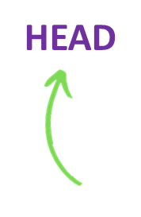
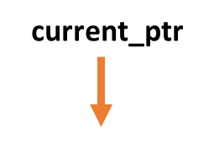

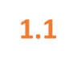
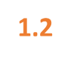
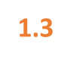
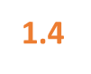
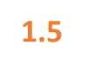

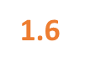
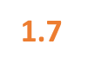
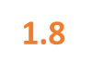
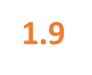
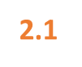
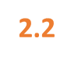
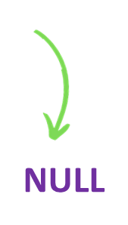

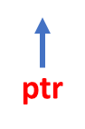



Growable Buffer with Panels
size_t panel_size = 5;
double data[11] = {1.1, 1.2, 1.3, 1.4, 1.5, 1.6,
1.7, 1.8, 1.9, 2.1, 2.2};
ACAT 2022
The Awkward World of Python and C++
1
Notes:
In the new implementation, instead of having just one pointer and reallocating and copying to grow the buffer, we use multiple panels that are allocated as needed i.e. when the GrowableBuffer runs out of space. We basically have a singly linked list where a next_ pointer each pointer points to the next panel.
The private member current_ptr becomes a pointer to a current panel.
Taking the previous example, In this approach, the Growable Buffer constructor allocates an empty panel with reserved number of slots and the append data one by one into the buffer till length is less than reserved similar to the previous approach. But once the panel gets completely filled, instead of reallocating and copying, a new panel with same size as previous panel is allocated and the remaining data is appended and once this panel is also filled, another panel is allocated and the rest of the data is appended. The panels are allocated with smart pointers: std::unique_ptr<PRIMITIVE[]>(new PRIMITIVE[reserved]), so no memory leaks occur.
The reason why the multiple panels approach is expected to be a step up in performance is that the GrowableBuffer is used to produce “snapshots” of accumulated data by converting them into Awkward Arrays. So the external code copies the data out of a GrowableBuffer so that it can own it, and since we have to do a copy anyway, we can as well concatenate in the same operation. With concatenation being "free," having no extra performance cost, we don’t necessarily need the buffer to be contiguous and can let it be discontiguous as it grows to avoid more expensive ways of growing a buffer like reallocating and copying. By using a Linked List it looks contiguous even though it is not.
The ptr of GrowableBuffer points to last element of last pointer.

Slide 15

to_buffers in Layout & Array Builders
const std::string
Float64Builder::to_buffers(BuffersContainer& container, int64_t& form_key_id) const {
std::stringstream form_key;
form_key << "node" << (form_key_id++);
buffer_.concatenate(
reinterpret_cast<double*>(
container.empty_buffer(form_key.str() + "-data",
buffer_.length() * (int64_t)sizeof(double))));
return "{\"class\": \"NumpyArray\", \"primitive\": \"float64\", \"form_key\": \""
+ form_key.str() + "\"}";
}
Float64 ArrayBuilder
(concatenates data, typecast, returns form)
void
to_buffers(std::map<std::string, void*>& buffers) const noexcept {
offsets_.concatenate(static_cast<PRIMITIVE*>
(buffers["node" + std::to_string(id_) + "-offsets"]));
content_.to_buffers(buffers);
}
ListOffset LayoutBuilder
(concatenates data and fills it in a map)
ACAT 2022
The Awkward World of Python and C++
2
Notes:
Now both Layout Builder and Array Builder have a similar interface for concatenating the buffers by using their respective to_buffers method. Both use the new Growable Buffers with multiple panels.
The LayoutBuilder concatenates data and fills it in a map of form name keys and user defined pointers whereas array builder also returns the form and casts the type (for example - from int64 to float64) besides concatenation.
Python binding invoke ArrayBuilder to_buffers. So, now the only full copy of the data is owned by Python. The memory management for data created by ArrayBuilder has dramatically changed in the last few versions, with more and more reliance on NumPy owning the data.

